Slide 1
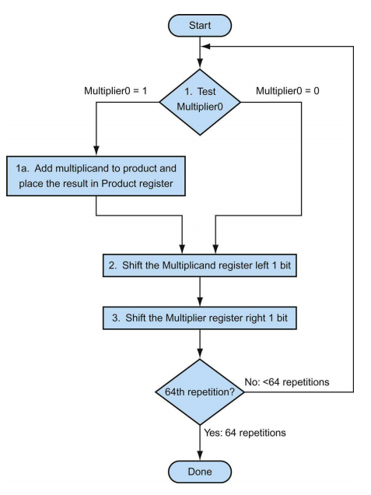
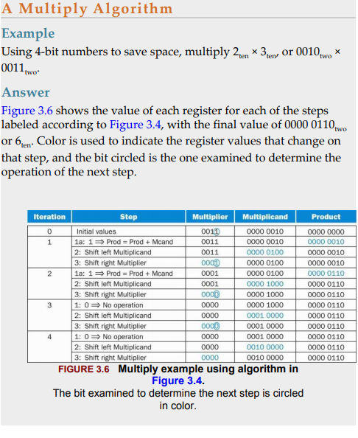

Slide 2
Flow chart above shows the three basic steps needed for each bit. The least significant bit of the multiplier (Multiplier0) determines whether the multiplicand is added to the Product register. The left shift in step 2 has the effect of moving the intermediate operands to the left, just as when multiplying with paper and pencil. The shift right in step 3 gives us the next bit of the multiplier to examine in the following iteration. These three steps are repeated 64 times to obtain the product.
The first operand is called the multiplicand and the second the multiplier. The final result is called the product. As you may recall, the algorithm learned in grammar school is to take the digits of the multiplier one at a time from right to left, multiplying the multiplicand by the single digit of the multiplier, and shifting the intermediate product one digit to the left of the earlier intermediate products. The first observation is that the number of digits in the product is considerably larger than the number in either the multiplicand or the multiplier. In fact, if we ignore the sign bits, the length of the multiplication of an n-bit multiplicand and an m-bit multiplier is a product that is n+m bits long. That is, n+m bits are required to represent all possible products. Hence, like add, multiply must cope with overflow because we frequently want a 64-bit product as the result of multiplying two 64-bit numbers.

Slide 3
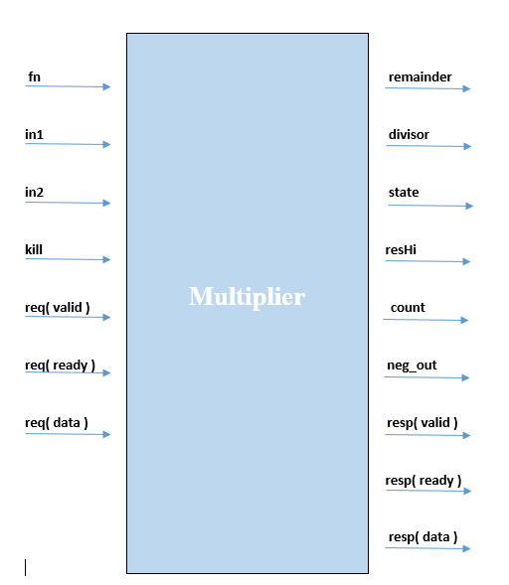
In this Multiplier block we have five number of classes
MultiplierReq (multiplier request)
MultiplierResp(Multiplier response)
MultiplierIO (Multiplier Input/Output)
MulDiv
PipelinedMultiplier
We have one case class name
MulDivParams
Block Diagram of Multiplier
Inputs | Outputs
fn (Aluop bits) | remainder (remainder result)
dw (data width) | divisor (divisor result)
In1(operand A of ALU) | state (in which state our Multiplier is)
In2(operand B of ALU) | resHi (result High)
Kill (Multiplier Input) | count (count register)
valid(req) | neg_out (negative output)
ready(req) | valid(resp)
data(req) | ready(resp)
- | data(resp)

Slide 4
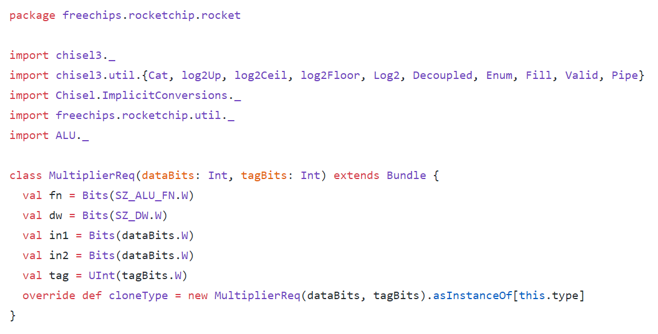
In Multiplier Block we import ALU block to use functions and input/outputs which we define in our ALU Block earlier.
We create a class MultiplierReq (Multiplier Request) and takes databits and tagbits as input parameter
We create method cloneType with override keyword (override allows you to use same method as defined in superclass)
cloneType method created an object of MultiplierReq class and clone its variable type using instanceof [this.type] command
Scala’s asInstanceOf method to cast an instance to the desired type. The isInstanceOf method can be a simpler approach to determining whether an object matches a type
this keyword in Scala is used to refer to the object of the current class. Using this keyword you can access the members of the class like variables, methods, constructors
Here this keyword returns the type.
MultiplierReq variables | Description
dw | Data width which can be 32bit or 64 bit
fn | We take Aluop bits as input, width is predefined by 4 in ALU Block
in2 | Operand B input.in2 length would be defined by databits
in1 | Operand A input, in2 length would be defined by databits
tag | Tagbits used to define the width of tag variable

Slide 5
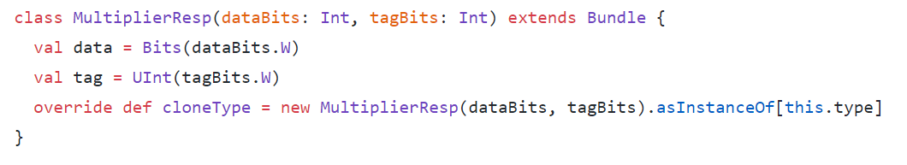
We create a class MultiplierResp (Multiplier Response) and takes databits and tagbits as input parameter
We create method cloneType with override keyword (override allows you to use same method as defined in superclass)
cloneType method created an object of MultiplierReq class and clone its variable type using instanceof [this.type] command
Scala’s asInstanceOf method to cast an instance to the desired type . The isInstanceOf method can be a simpler approach to determining whether an object matches a type
this keyword in Scala is used to refer to the object of the current class. Using this keyword you can access the members of the class like variables, methods, constructors
Here this keyword returns the type.

Slide 6
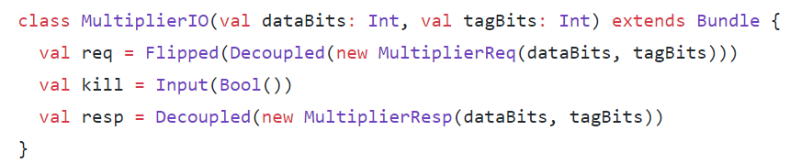
We create a class MultiplierIO (Multiplier input and output) which takes databits and tagbits as input parameter.
We use Decoupled and Flipped commands in order to use input and output readyvalidinterface. Chisel provides a standard interface for ready-valid interfaces we use the utility function Decoupled() to turn any type into a ready-valid interface rather than directly using ReadyValidIO
Decoupled() creates a producer(which outputs data) / output ready-valid interface (i.e. bits is an output).
Flipped(Decoupled() creates a consumer (which receives data)/ input ready-valid interface (i.e. bits is an input).
Where a ready-valid interface consists of a ready signal, a valid signal, and some data stored in bits
https://github.com/freechipsproject/chisel3/wiki/Interfaces-Bulk-Connections
MultiplierIO variables | Description
req | req variable is an input readyvalidinterface which we uses by creating an object of MultiplierReq
kill | kill is an input Bool variable
resp | resp variable is an output readyvalidinterface which we uses by creating an object of MultiplierResp

Slide 7
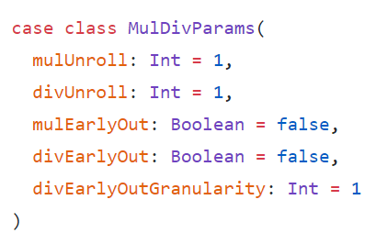
We created a case class MulDivParams(Multiplication Division Parameter).We creates case class as they are good for modeling immutable data.
keyword new was not used to instantiate the case class. This is because case classes have an apply method by default which takes care of object construction.
MulDivParams variables | Description
mulUnroll | This variable is used for calculating minimum multiply latency. We initializes it with 1.
divUnroll | This variable is used for calculating minimum division latency. We initializes it with 1.
mulEarlyOut | Multiplication early output which is false by default. This variable is used for calculating minimum multiply latency
divEarlyOut | division early output which is false by default. This variable is used for calculating minimum division latency
divEarlyOutGranularity | divEarlyOutGranularity parameter to tune size/delay of early-out circuit

Slide 8
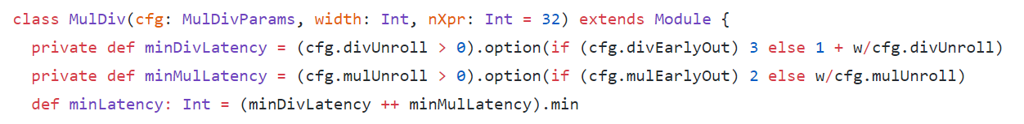
We created a class MulDiv which creates an object of case class MulDivParams by assigning reference variable cfg and takes as input parameter ,width and nXpr (nXpr is used for tagbits of class MultiplierIO) is also taken as input parameter
We created private minDivLatency function which means this function cannot be used outside of this class. This method implements that divUnroll will always be greater than 0
We have uses the option method of scala which means It returns Some(Result) if condition succeeds with result R and None if condition fails. In option we have if condition which returns 3 if divEarlyOut is true otherwise it will calculate value by using w(variable which return width length which is either 32 or 64) and divUnroll variable which we declare as 1 and add result to 1.
We created private minMulLatency function which means this function cannot be used outside of this class. This method implements that mulUnroll will always be greater than 0
We have uses the option of Scala which means It returns Some(Result) if condition succeeds with result R and None if condition fails. In option we have if condition which returns 2 if mulEarlyOut is true otherwise it will calculate value by using w(variable which return width length) and mulUnroll variable which we declare 1.
We define a method minLatency which tells which method has minimum latency between minDivLatency and minMulLatency.

Slide 9
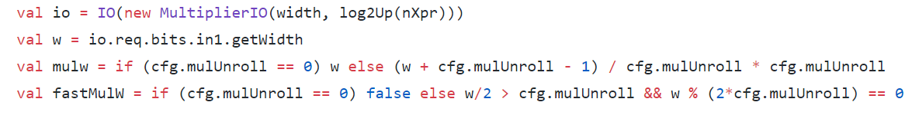
We initializes reference variable io and creates a new object of class MultiplierIO in it by taking width and nXpr log2up as its input parameter, Width which is data bits and log2up(nXpr) which is our tag bits of MultiplierIO class
We created a variable w which gives the width of require bits of in1(operand A of ALU) by using getWidth function
mulw variable is used to calculate multiplication width. We have uses if condition which says if mulUnroll is equals to 0 we will have w variable in mulw otherwise we will execute else statement which makes the w (width) value as it is define above by subtraction and multiplication and division operation
fastMulw variable is used to calculate multiplication width for faster multiplication computation. We have uses if condition which says if mulUnroll variable is equals to 0 we will have false as output in fastMulw, otherwise we will execute else statement which uses And condition and result with 0 or 1

Slide 10
We add eight variables (states) in our list by using cons operator and Enum command indicated how many states we have in our list
We creates variable state and initializes it as register by using RegInit command and takes s_ready state variable as input
States | Description
s_ready | This states indicates ready state
s_neg_inputs | This states indicates the status if we have negative input
s_mul | This states indicates the status of multiplication state
s_div | This states indicates the status of division state
s_dummy | This states indicates the status of dummy state
s_neg_output | This states indicates the status of negative output
s_done_mul | This states indicates the status of multiplication operation completion
s_done_div | This states indicates the status of division operation completion

Slide 11
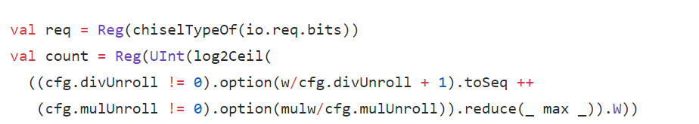
We initializes a variable req and created a register using Reg .ChiselTypeOf object in Scala returns the type of required bits
In count variable we have the number of register bits. If the register bits is of 4 then multiplication should be complete in 4 cycles, If our count value is 0 we get our result and we end the operation
log2Ceil function of chisel is used to take log2 of a Scala integer, rounded up. Useful for getting the number of bits needed to represent some number of states
We have declared divUnroll variable as 1 so we have true condition .
Use Option class when returning a value from a function that can be null .The Option in Scala is referred to a carrier of single or no element for a stated type. When a method returns a value which can even be null then Option is utilized i.e, the method defined returns an instance of an Option, in place of returning a single object or a null.
We uses the toSeq() method which is utilized to display a sequence from the Scala map.
We have declared mulUnroll variable as 1 so we have true condition .We uses the Reduce function which is applied on collection data structure in Scala that contains lists, sets, maps, sequence and tuples and combines them using a binary operation to produce a single value.
We uses max function which will generate the maximum number of the given to conditions
https://www.geeksforgeeks.org/scala-option/ https://alvinalexander.com/scala/using-scala-option-some-none-idiom-function-java-null/

Slide 12
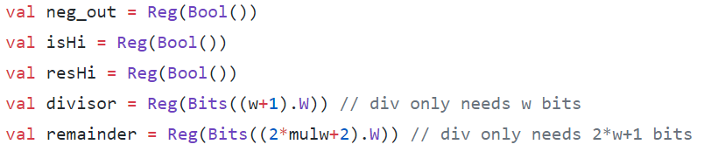
We created four registers without initialization and declared their type as Bool. Variables included neg_out(negative output),isHi(is High), resHi(result high). We uses these register later in our code below
We have divisor variable in which we creates divisor register by using Reg command and having w+1 width
We have remainder variable in which we creates remainder register by using Reg command and having 2*mulw+2 width where mulw is used to calculate multiplication width

Slide 13
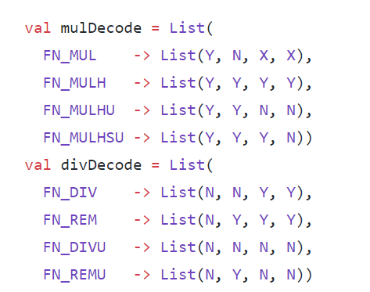
We have created variable mulDecode in which we create List and assign key with values .We have different multiplication operation which we define in our ALU block we assign them with different List values. Values in our list is compared by the command of BitPat command in our Decode block. X,Y and N are methods define in Constants block
We have created variable divDecode in which we create List and assign key with values we have different division operation which we define in our ALU block we assign them with different List values. Values in our list is compared by the command of BitPat command in our Decode block. X,Y and N are methods define in Constants block

Slide 14
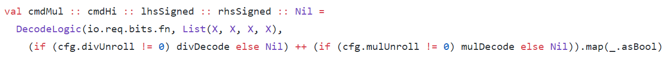

We add four variables to the list cmdMul, cmdHi, lhsSigned and rhsSigned by using cons operator (::)
We uses Decode Logic class and takes fn(Aluop)bits as input with List(X,X,X,X) where X is a method define in Const block of and this X uses BitPat command of Scala for bit matching .
We have if condition in which if divUnroll is not equals to 0 we will select divDecode else Nil will be selected, we have another if condition which indicates if mulUnroll is not equals to 0 we will select mulDecode else Nil will be output in both the condition we uses _.asBool to get output of all condition as true or false
The map method takes a predicate function and applies it to every element in the collection. It creates a new collection with the result of the predicate function applied to each and every element of the collection.
We have require method which will only execute if w is equals to 32 or 64.
We have halfWidth method which takes MultiplierReq class as input parameter and returns some result by executing AND condition .If we have w greater than 32 result will output as Bool and req.dw(data width )=32 it will outputs true than we perform AND condition between them

Slide 15
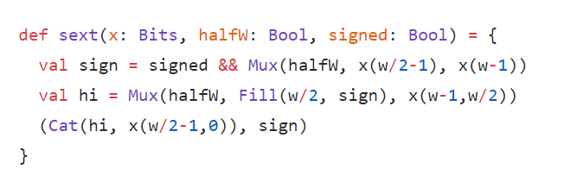
We have define a method sext and takes three parameters as input which includes x(number of Bits), halfw (half width) and signed (weather number is signed or unsigned)
We created variable sign and uses Mux and AND condition in it which means this variable will return the result from these condition, In sign variable(w/2 -1) will gives the half width if we have w=32 this formulation will gives 15 which means 0 to 15 bits
We created a variable hi which main purpose is to fill the MSB of sign variable result obtain in above line of code
We than concatenate the result of hi ,x(w/2-1,0) and sign variable

Slide 16
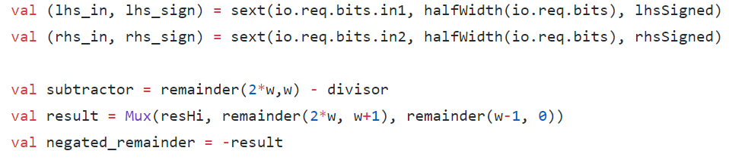
We created a variable lhs_in(left hand side input) and lhs_sign(left hand side signed) by using method sext define above, it takes in1(operand of ALU) bits as 1st input parameter and 2nd input parameter of sext method will be the result of halfWidth method which takes req bits as input and 3rd parameter is lhsSigned
We created a variable rhs_in(right hand side input) and rhs_sign(right hand side signed) by using method sext define above, we take in2(operand of ALU) bits as 1st input parameter and 2nd input parameter of sext method will be the result of halfWidth method which takes req bits as input and 3rd parameter is rhsSigned
We create variable subtractor which subtract divisor from remainder by taking double of width and width as remainder method parameter
We have result variable in which we uses Mux condition of resHi(result High Bool parameter of Mux) if this is high we have remainder double of width, width with add 1 will be selected otherwise we have remainder with width subtraction of 1, 0 will be selected
We have negated_remainder variable in which store result with negative sign

Slide 17
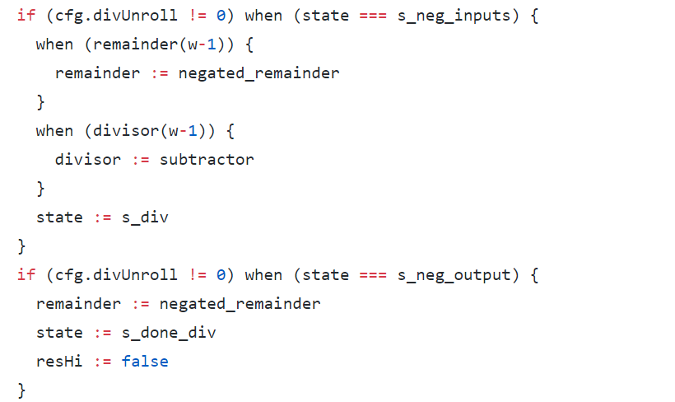
We have if condition in which we check if divUnroll is not equals to 0 we execute further code and check state when state is equals to s_neg_inputs (negative input state) we have two conditions as follows
We wired negated_remainder result to the remainder by taking w-1 as remainder parameter
We wired subtractor result to the divisor by taking w-1 as divisor parameter. We than finally wired s_div(state_div) with state output
We have second condition of if in which we check if divUnroll is not equals to 0 we execute further code and check state when state is equals to s_neg_output (negative output)
We wired negated_remainder variable result to the remainder
We wired s_done_div (state of completion of division operation) with state output. resHi(result High) will be wired with False Bool

Slide 18
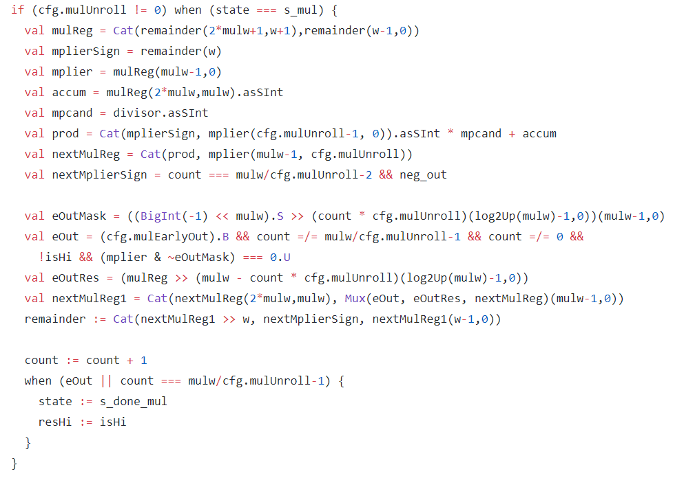
Variables | Description
mulReg | Multiplication register variable in which we have concatenated remainder (remainder is the register) bits by applying operations with w(width)
mplierSign | We have multiplierSign variable in which we have remainder register having width as its input
mplier | We have multiplier variable in which we uses mulReg variable as input
accum | Accumulator variable uses mulReg variable and converts it as Signed Integer
mpcand | Multiplicand variable is used to convert divisor variable as signed Integer
prod | In product Variable we uses Cat function to concatenate bits and then perform multiplication operation between multiplier and multiplicand and converts the result to Singed Integer and than add accumulator variable with the result
nextMulReg | Next Multiplication Register variable uses Cat function and concatenate product, multiplier and mulUnroll variable
nextMplierSign | Next Multiplier Sign uses count register and compares it result with mulw/cfg.mulUnroll-2 expression if it satisfies we apply AND condition with neg_out(negative output) and saves the result in the nextMplierSign variable
We have if condition in which we check if mulUnroll is not equals to 0 we execute further code and check state when state is equals to s_mul (state of multiplication) we declared these variables

Slide 19
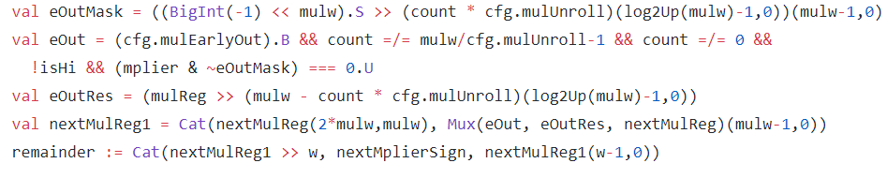

Slide 20
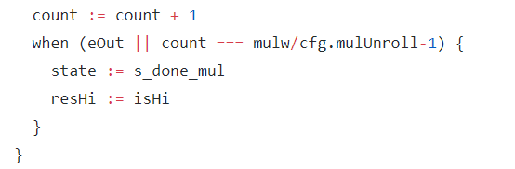
We wired count with count+1
We have when condition which will execute when eout or count is equals to mulw/cfg.mulUnroll-1 if this condition satisfies we execute when block.
In when block we wired state with s_done_mul(state of done multiplication operation) and resHi(result high) get wired with isHi.

Slide 21
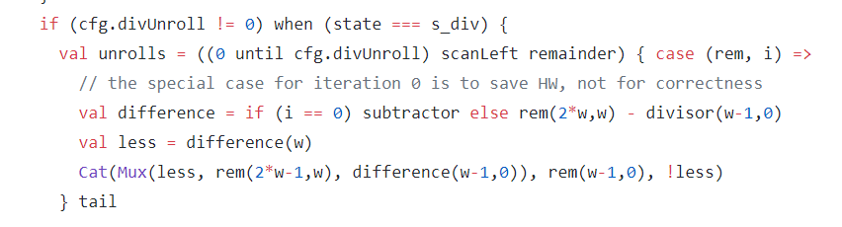
We have if condition in which we compares divUnroll variable if its not equals to 0 we have when condition in which we compare state with s_div(state of division operation) if that condition satisfies
We use until keyword in unroll variable, so that 1 will not included which is the value of divUnroll variable. We also uses scanLeft function. ScanLeft and scanRight walk through a sequence in a manner similar to reduceLeft and reduceRight, but they return a sequence instead of a single value. We have remainder variable as scanLeft parameter
We uses case and takes rem and I as its input for matching
We have difference variable in which we have if condition which compares I with 0 if this condition satisfies subtractor will be selected otherwise rem-divisor result will be selected
We have less variable in which we have difference variable which takes w variable as input
We than concatenate on the bases of Mux bool parameter we will select rem (w-1) or variable of less as inverse. The tail method returns a collection consisting of all elements except the first one.

Slide 22
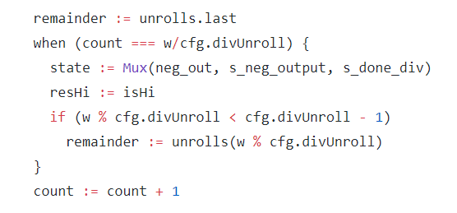
We wired unrolls.last result with remainder We have when condition in which we compare count with w/divUnroll variable if that satisfies we check Mux condition and neg_out(negative output) is as Bool parameter on this Bool Parameter we decide weather s_neg_output(state of negative output) or s_done_div(state of division done is selected) isHi will be wired with resHi(result High)
We have If condition in which we check less than operation between the remainder of (w and divUnroll variable) and divUnroll variable with subtraction of 1
We take remainder result of w and divUnroll and inputs that in unrolls variable and wired that result with remainder
We finally wired between count +1 result with count

Slide 23
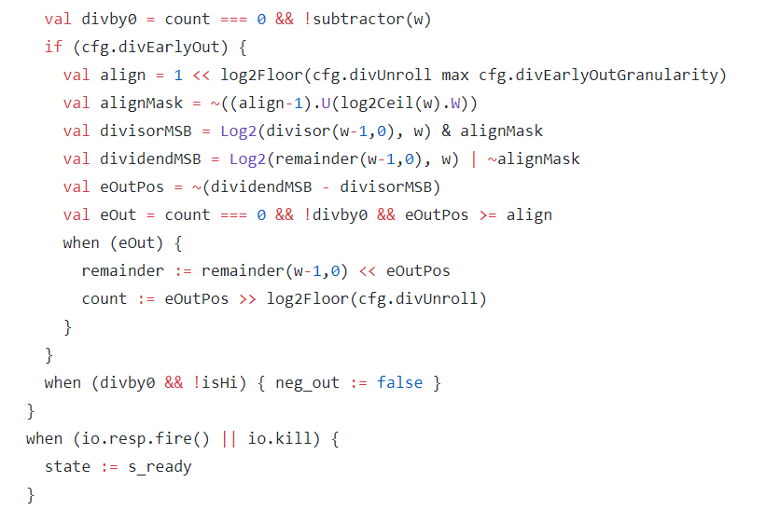
divby0 variable will have AND condition between count and notsubtractor which takes w as a parameter
We have divEarlyOut variable in if condition if its true if condition executed We have align variable in which we use log2Floor which compute the log2 of a Scala integer, rounded down. We uses max function which return maximum value between divEarlyOutGranularity and divUnroll variable We have alignMask variable in which we use ~. Binary Ones Complement Operator is unary and has the effect of 'flipping' bits.log2Ceil command also uses to compute the log2 of a Scala integer, rounded up. Useful for getting the number of bits needed to represent some number of states We uses divisor MSB variable to extract MSB of divisor We uses Dividend MSB to extract MSB of dividend
We have eoutPos variable in which we subtract dividend MSB with divisor MSB and takes the complement
We have eOut variable which have AND and equals condition through which it returns 1 or 0 Furthermore we have when condition which executes only of eout is 1 or true In when statement we wired remainder and count variable We have another when in which we have AND condition between divby0 and notisHi variable if that satisfies neg_out(negative output) will be wired as false
We have another when which have OR condition between kill and resp fire variable id condition satisfies we wired state with s_ready where If ready and valid are both high, a transaction occurred (sometime called fire)

Slide 24
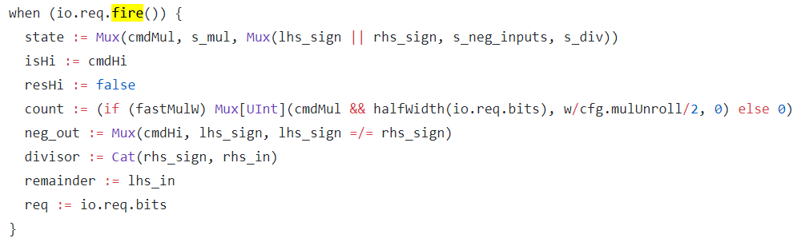
We have when condition if we have valid and ready state of request we execute further instructions We have state variable which uses Mux condition and cmdMul act as Bool parameter of Mux if condition satisfies s_mul(state of multiplication) is selected otherwise we have 2nd Mux which has OR condition between lhs_sign and rhs_sign as Bool parameter of Mux which decides weather s_neg_inputs is selected or s_div We have isHi variable which is wired with cmdHi, whereas resHi output is wired as false count is wired by executing if condition if fastMulw is true we have further code of lines executed below . We have Mux which returns UInt type by executing its Bool operator AND condition between cmdMul and halfWidth. If condition satisfies we select w/mulUnroll/2 otherwise 0 We have else clause wh9ch returns 0 We have neg_out output which is wired by using Mux condition in which we have cmdHi as Bool parameter which decides wether lhs_sign selected or comparison result of lhs_sign and rhs_sign is selected Divisor output is wired with rhs_sign and rhs_in by using Cat function remainder is wired with lhs_in and req is wired with request bits.

Slide 25
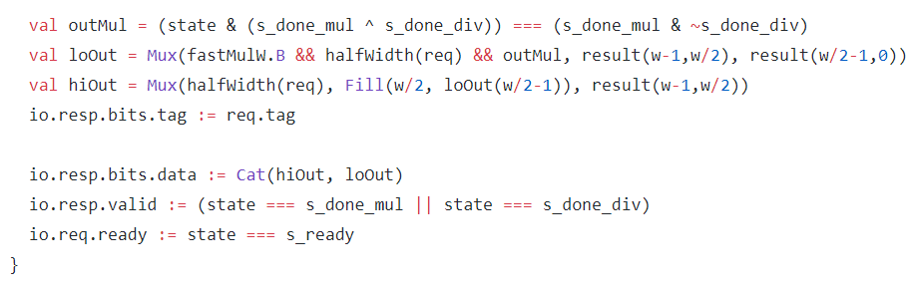
We have variable outMul in which we compares to condition 1st condition is we take xor between s_done_mul and s_done_div and than takes AND with state variable 2nd condition is we take AND between s_done_mul and compliment of s_done_div We have loOut variable which outputs the low bits result by executing Mux and AND conditions between fastMulw, halfWidth and outMul.On that basis result of half of width will be selected
We have hiOut variable which outputs the high bits result by executing Mux and Fill command. HalfWidth act as a Bool parameter of Mux.On that basis result of half of width will be selected resp bits tag gets wired with req.tag response data bits wires with hiOut and loOut by using Cat function response valid and req ready is also wired by comparing states with multiplication, division and ready respectively

Slide 26
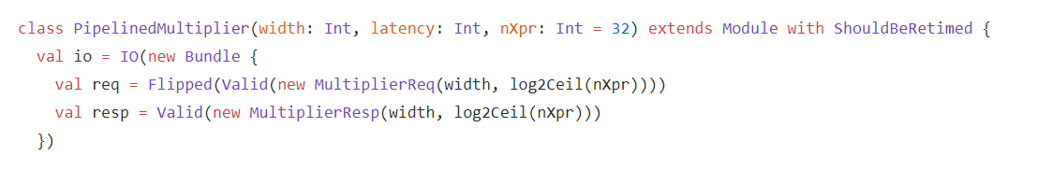
We create a class PipelinedMultiplier and takes width latency and nXpr=32 as input parameter
We have variable req in which we creates object of class MultiplierReq and takes width and nXpr value log as input parameter. A bit that will be asserted when bits is valid.We have Flipped that valid bits using flipped command We have resp variable which do same operation as resp variable instead this cannot flipped valid bits result

Slide 27
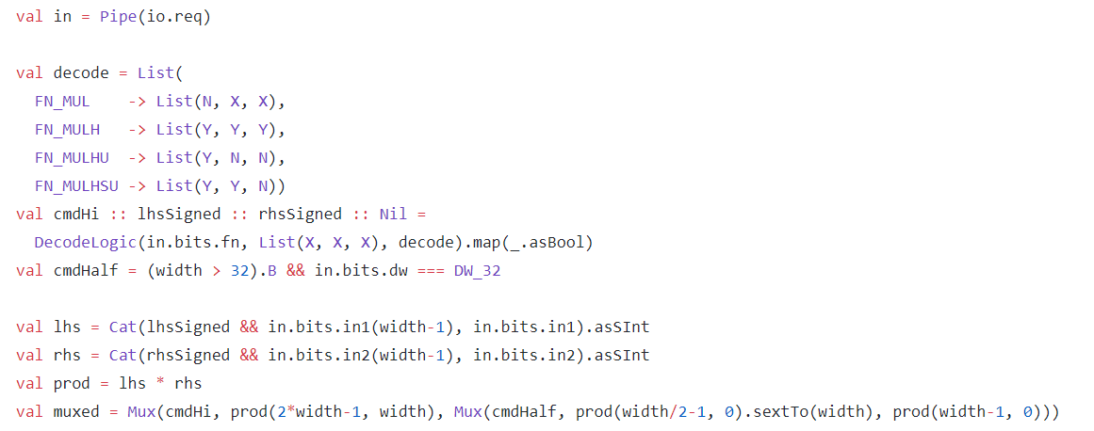
We have variable in in which we take uses Pipe method and takes io.req as input We have created variable decode in which we create List and assign key with values we have different multiplication operation which we define in our ALU block we assign them with different List values. Values in our list is compared by the command of BitPat command in our Decode block. X,Y and N are methods define in Constants block We add three variables to the list cmdHi, lhsSigned and rhsSigned in our list by using cons operator
We uses Decode Logic class and takes fn(Aluop)bits as input with List(X,X,X) where X is a (method define in Const block of Scala and this X uses BitPat command of Scala for bit matching)and decode.map. We have variable cmdHalf in which we compare width with 32 and than apply AND condition with equals condition of data width of 32 and bits.dw We have lhs and rhs variable which we uses to multiply and stores the result in prod variable. We than uses muxed variable in which we used Mux cmdHi as Bool parameter of Mux

Slide 28
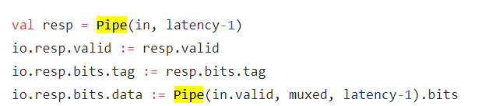
We have wired response valid, bit tags and bit data with io.resp.valid,io.resp.bits.tag,io.resp.bots.data

Slide 29
56 and 57
https://alvinalexander.com/scala/examples-scala-sequences-collection-methods-seq-list-array-buffer/ scan left

